Slide 1
Halo everyone！

Slide 2
How Do Middle Schools Kill Student's Creativity
Chenyang Zhao (from the school of software)
2020/10/22

Slide 3
Contents
01
02
03
04
05
The famous TED talk
Immense diversity
What or Which
What do Middle schools do?
Learn to choose

Slide 4
The famous TED talk
1

Slide 5


The famous TED talk
Do schools kill creativity

Slide 6
University is a fairyland full of immense diversity
2

Slide 7


Slide 8
We have massive diversity of choices, to which we attach great significance.

Slide 9
what to eat
3.1

Slide 10
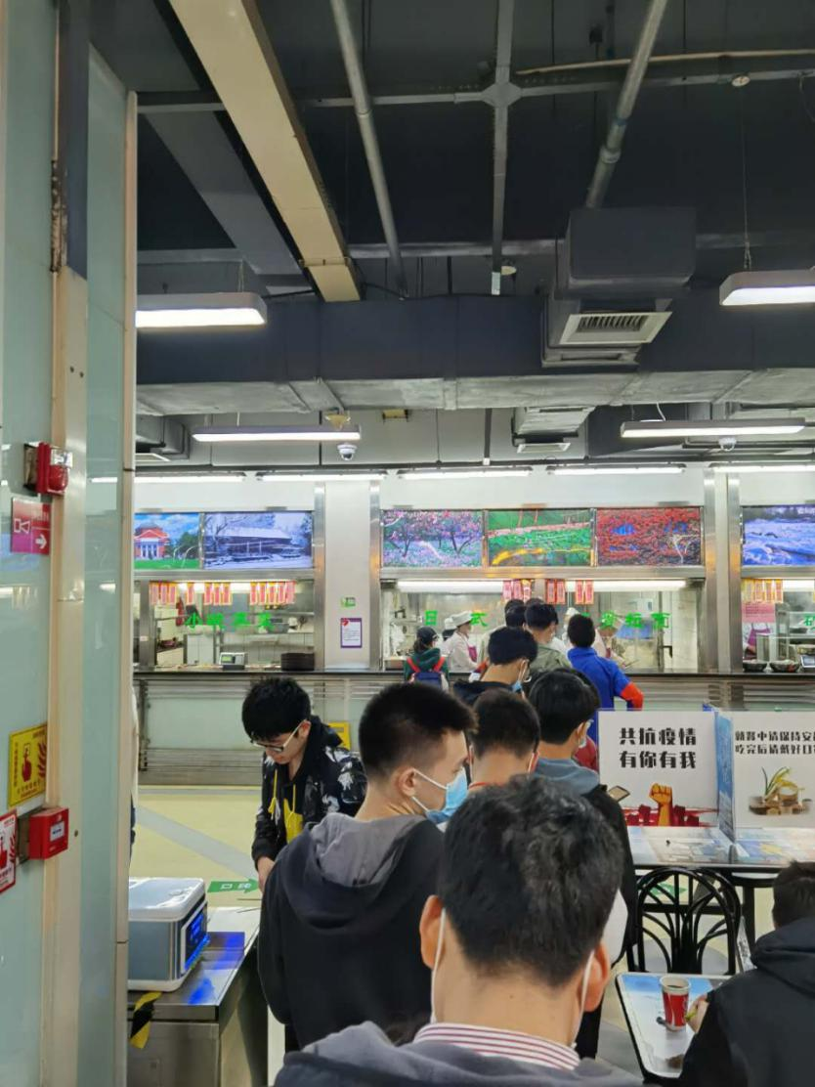

What to eat

Slide 11
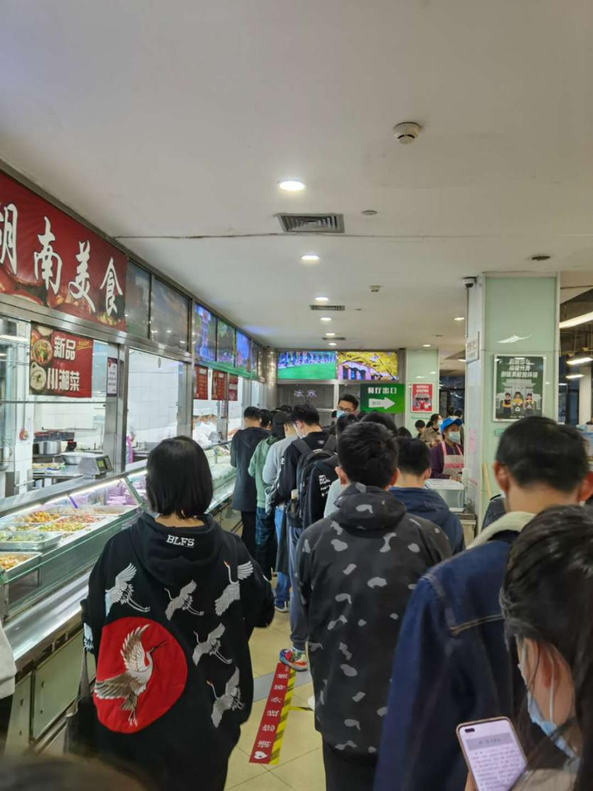

the fourth floor of ZIjing
YYDS !

Slide 12
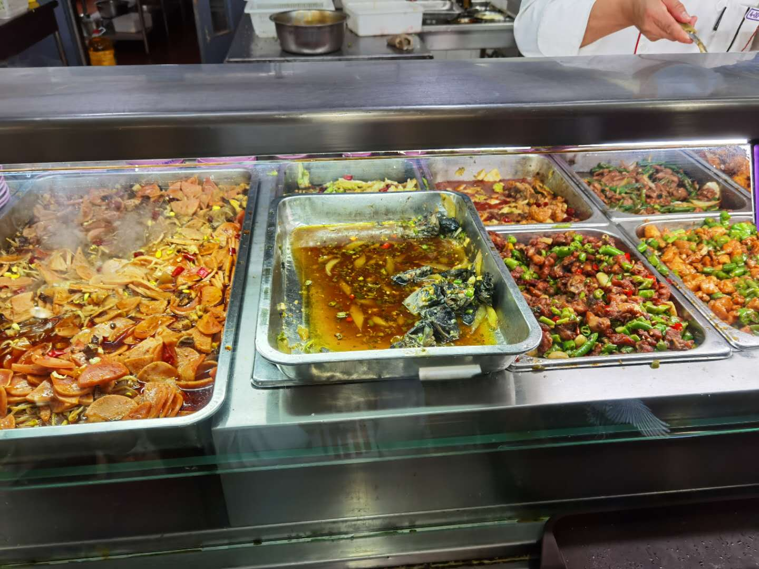


Slide 13
Which to choose
3.2

Slide 14
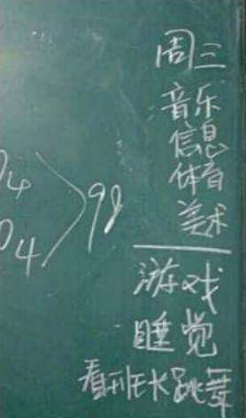
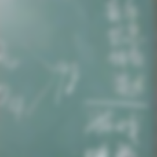
You may be thinking of this in middle school

Slide 15
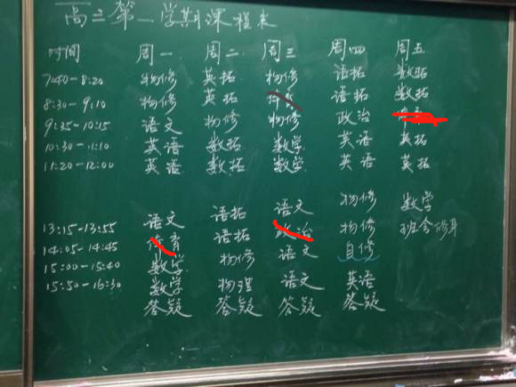
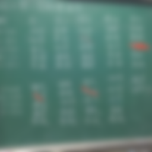
But actually
NO PE
NO PE
NO PE

Slide 16
Now we have thousands of courses that we can choose and enjoy
The course you choose now have direct influence on your life equality and happiness degree

Slide 17
For example
If you choose a course like this

Slide 18
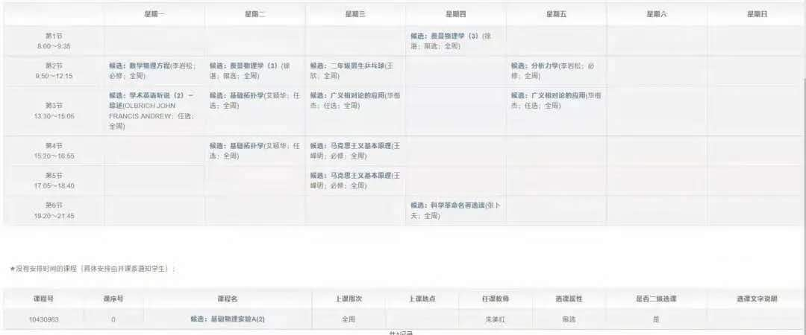

All in Waiting list

Slide 19
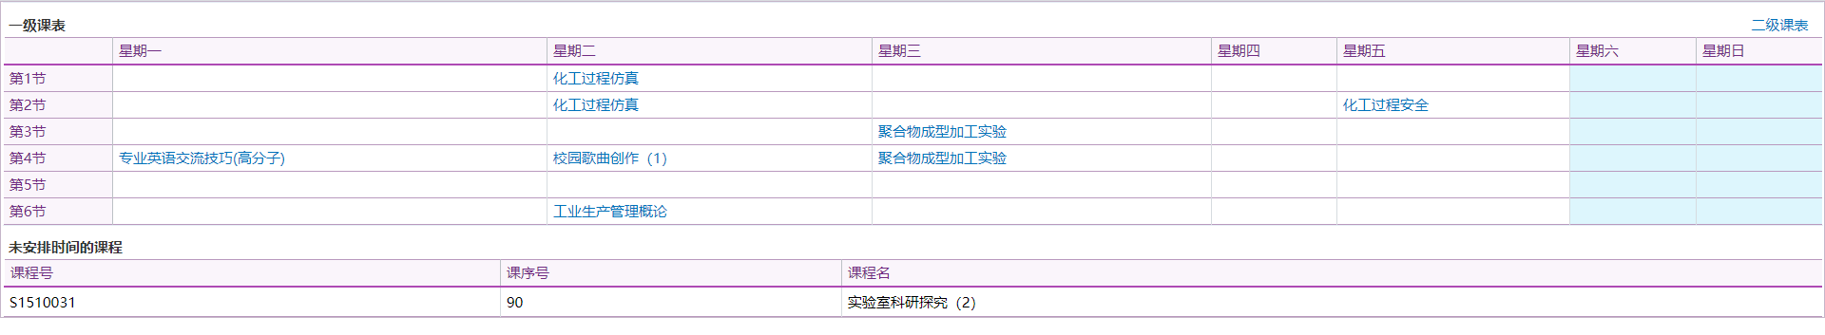

or this
5 courses a week

Slide 20
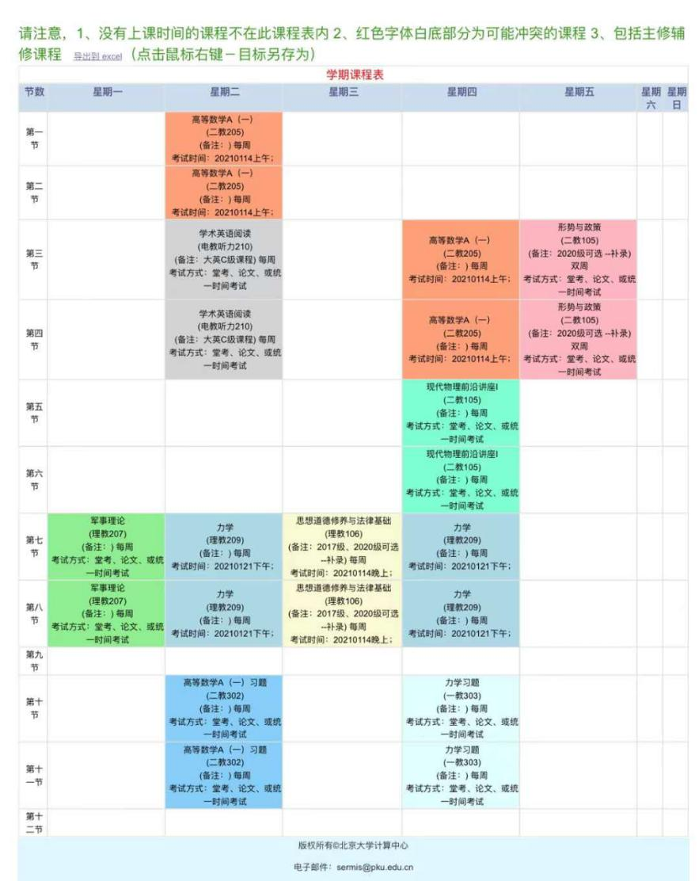
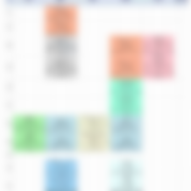
or even this
fatal Tuesday
and killing-life Thursday

Slide 21
What to do
3.3

Slide 22
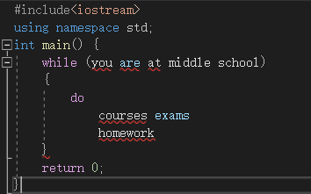

At middle school
courses，exams，homework
Then courses，exams，homework

Slide 23
But Now

Slide 24
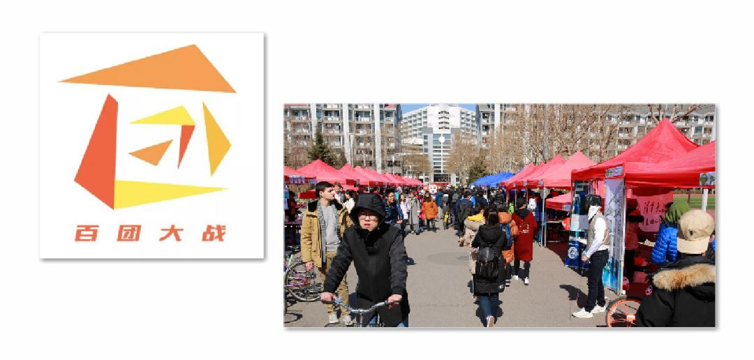


Slide 25
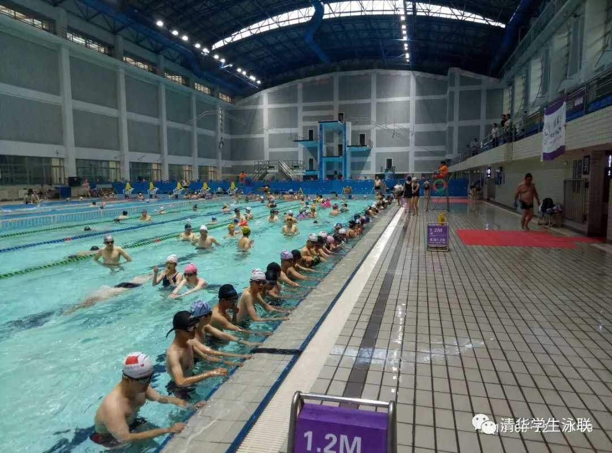


Slide 26


And this

Slide 27
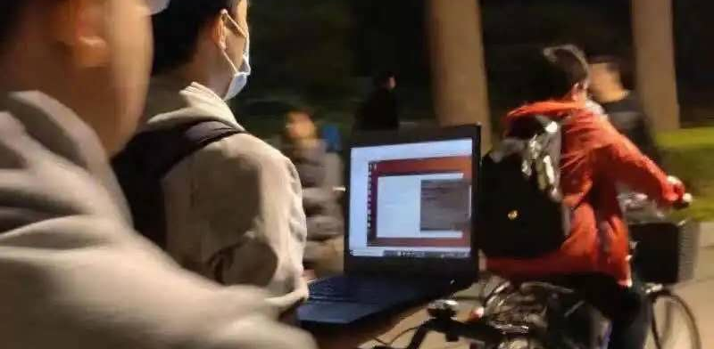

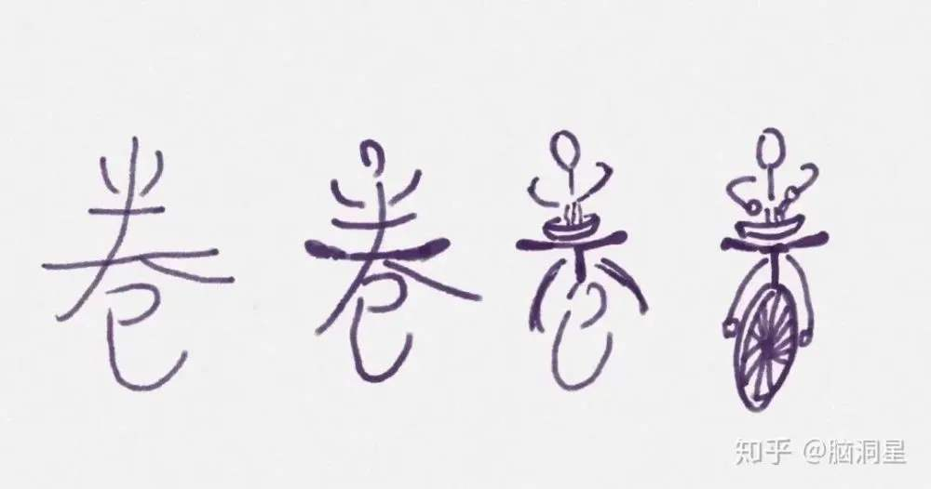
Even this

Slide 28

Conlusion
Massive choice is fairly charming and important，but with unpredictable risk and unbearable price

Slide 29
What have middle schools done?
4

Slide 30
Sir Robinson stressed
In our national education system, mistakes are the worst thing to make.
But if you don't prepare to be wrong, you can hardly come up with something really creative.

Slide 31
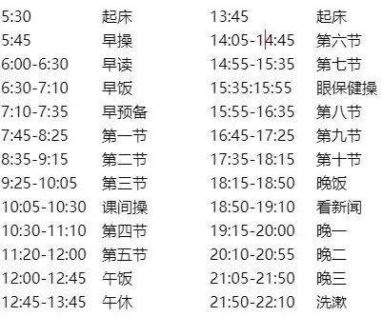

enroll in a famous middle school
Exert all our time and efforts
take the college entrance exam

Slide 32
And in the end

Slide 33



Slide 34
And in the end

Slide 35
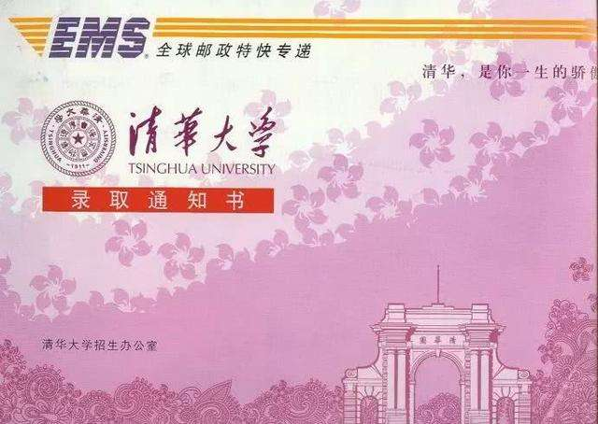


Slide 36
Our capacity for making proper choices which are suitable for ourselves most is
JUST DEPRIVED

Slide 37
At middle school, we don't have to choose.
We are chosen.
We just fake it as if it is decided by ourselves

Slide 38
Learn to choose
5

Slide 39
Crucial problem!
We are college students right now
Who will make the decisions for ourselves instead of ourselves???

Slide 40
Generalize
Most of our middle school education deprive us of capacity and courage for making decisions by ourselves, which leads to the lack of capacity.

Slide 41
Thanks

